Slide 1


SWARNANDHRA
College of Engineering and Technology
(Autonomous)
Permanent Affiliated to JNTUK, Kakinada, Approved by AICTE
Narsapur, Andhra Pradesh 534280,India
Department Of Artificial intelligence and Machine Learning
Project Title: COLLABORATIVE FILTERING-BASED BOOK RECOMMENDER SYSTEM USING MACHINE LEARNING
Ch. Bhagya Lakshmi - 22A21A6112
K. Sravanthi -22A21A6148
K. Asha Devi – 22A21A6141
N. Naga Sai Lahari – 22A21A6163
Project Guide : V. Durga Rao
Assistance Professor , M.Tech , PhD

Slide 2
Abstract
Recommender systems are widely used to predict user preferences and provide personalized suggestions. Collaborative filtering is a popular technique that recommends items based on similarities between users or items.
These systems use both explicit data (ratings, reviews) and implicit data (user interactions) to understand user behavior and improve recommendation accuracy.
Collaborative filtering is widely used in real-world applications such as Amazon and is often combined with other techniques to enhance recommendation performance. It enables users to efficiently discover relevant items from large datasets without manual searching. By analyzing user behavior and preferences, this approach improves overall user satisfaction by delivering accurate and meaningful recommendations.

Slide 3
Literature Survey
S. No | Author(s) | Title | Year | Contributions
1 | G. Linden, B. Smith, J. York | "Amazon.com Recommendations: Item-to-Item Collaborative Filtering" | 2003 | Introduced item-to-item collaborative filtering used to recommend products based on user behavior.
2 | J. L. Herlocker, J. A. Konstan | "Evaluating Collaborative Filtering Recommender Systems" | 2004 | Proposed methods to evaluate recommendation accuracy using user similarity techniques.
3 | Y. Koren, R. Bell, C. Volinsky | "Matrix Factorization Techniques for Recommender Systems" | 2009 | Improved recommendation accuracy and scalability using matrix factorization methods.
4 | X. Su, T. M. Khoshgoftaar | "A Survey of Collaborative Filtering Techniques" | 2009 | Reviewed different collaborative filtering methods including user-based and item-based approaches.
5 | J. Bobadilla, F. Ortega, A. Hernando | "Recommender Systems Survey" | 2013 | Provided an overview of recommendation techniques and improvements in collaborative filtering systems.

Slide 4
Problem Statement
The objective of this project is to implement an online book recommendation system using collaborative filtering.
In today’s digital world, users are exposed to a large number of books, making it difficult to select relevant ones based on their interests. Existing systems often provide general recommendations and do not effectively analyze user preferences.
A recommender system provides personalized suggestions based on user behavior and past interactions. However, traditional systems mainly depend on user ratings and fail when sufficient data is not available.
To overcome these limitations, the proposed system uses collaborative filtering to identify similarities between users and items and recommend relevant books.
The system aims to improve recommendation accuracy and help users discover suitable books efficiently.

Slide 5
Existing System and Disadvantages
Current book recommendation systems often rely on traditional methods such as popularity-based suggestions and manual curation, which present several limitations:
Lack of Personalization: Traditional systems provide the same recommendations to all users without analyzing individual preferences or behavior.
Lower Recommendation Accuracy: Since recommendations are based on general trends rather than user-specific data, the accuracy of suggestions is limited.
No Intelligent Learning: Existing systems do not use machine learning techniques to adapt and improve recommendations over time.
No NLP-Based Summary Generation: These systems do not generate book summaries using Natural Language Processing, making it difficult for users to quickly understand the content of a book.
Time-Consuming Search Process: Users must manually browse and search for books, which reduces efficiency.
Poor User Engagement: Due to lack of personalization and intelligent features, user interaction and satisfaction remain low.

Slide 6
Proposed System
It analyzes user ratings and preferences to find similarities between books using cosine similarity. Based on these similarities, the system recommends relevant books to users.
The system uses item-based collaborative filtering to generate accurate recommendations from large datasets.
It also includes NLP-based book summary generation, helping users quickly understand book content.
The proposed system is an online book recommendation system based on collaborative filtering.
This approach improves recommendation accuracy and enhances user experience.

Slide 7
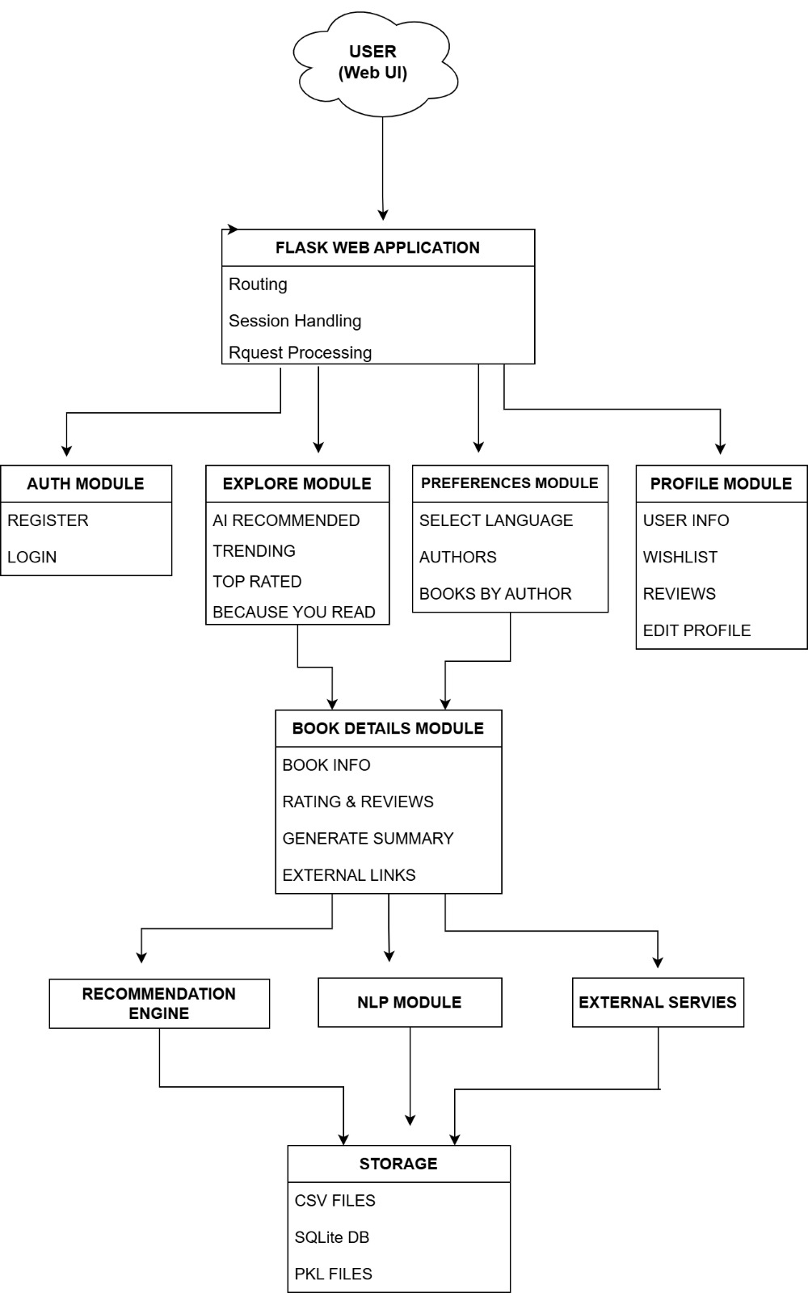
System architecture

Slide 8
Tech Stack
Frontend
HTML
CSS
Bootstrap
JavaScript
Jinja2 (Flask Templates)
Backend
Python
Flask (Web Framework)
Machine Learning
Collaborative Filtering
Cosine Similarity
Libraries Used
Pandas (Data Processing)
NumPy (Numerical Operations)
Scikit-learn (Similarity Calculation)
Pickle (Model Storage)
Natural Language Processing
NLP techniques for book summary generation
Database
SQLite

Slide 9
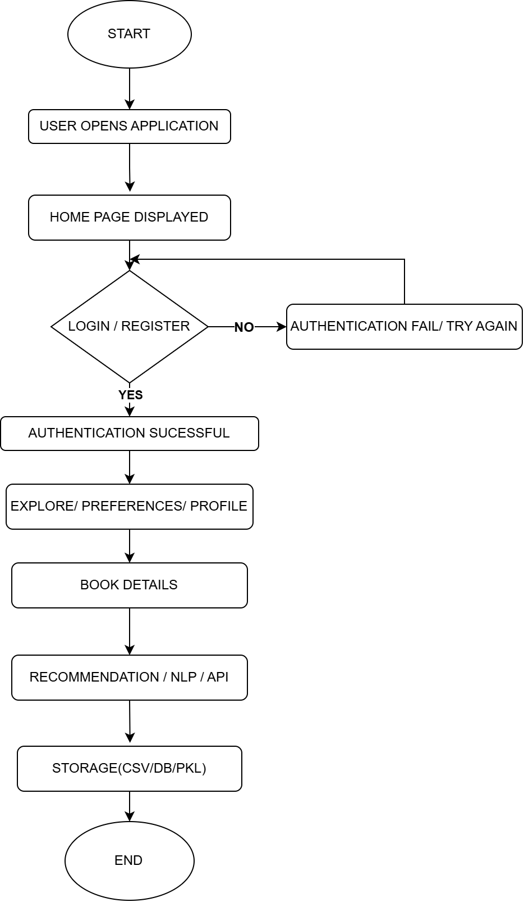
Work Flow Diagram

Slide 10
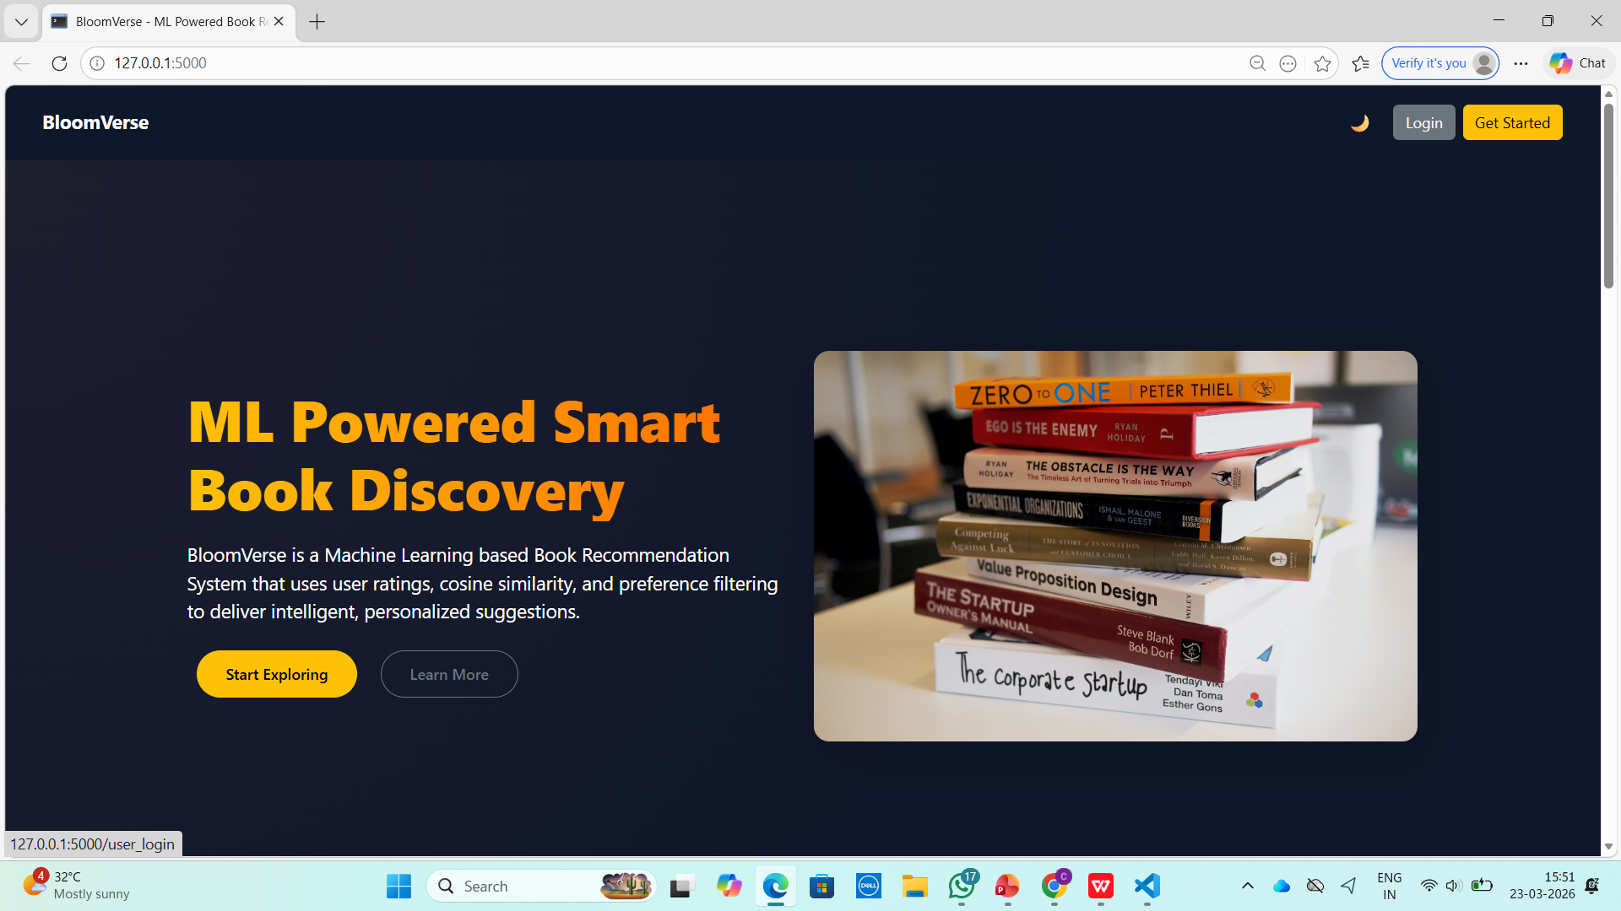
System Output

Slide 11
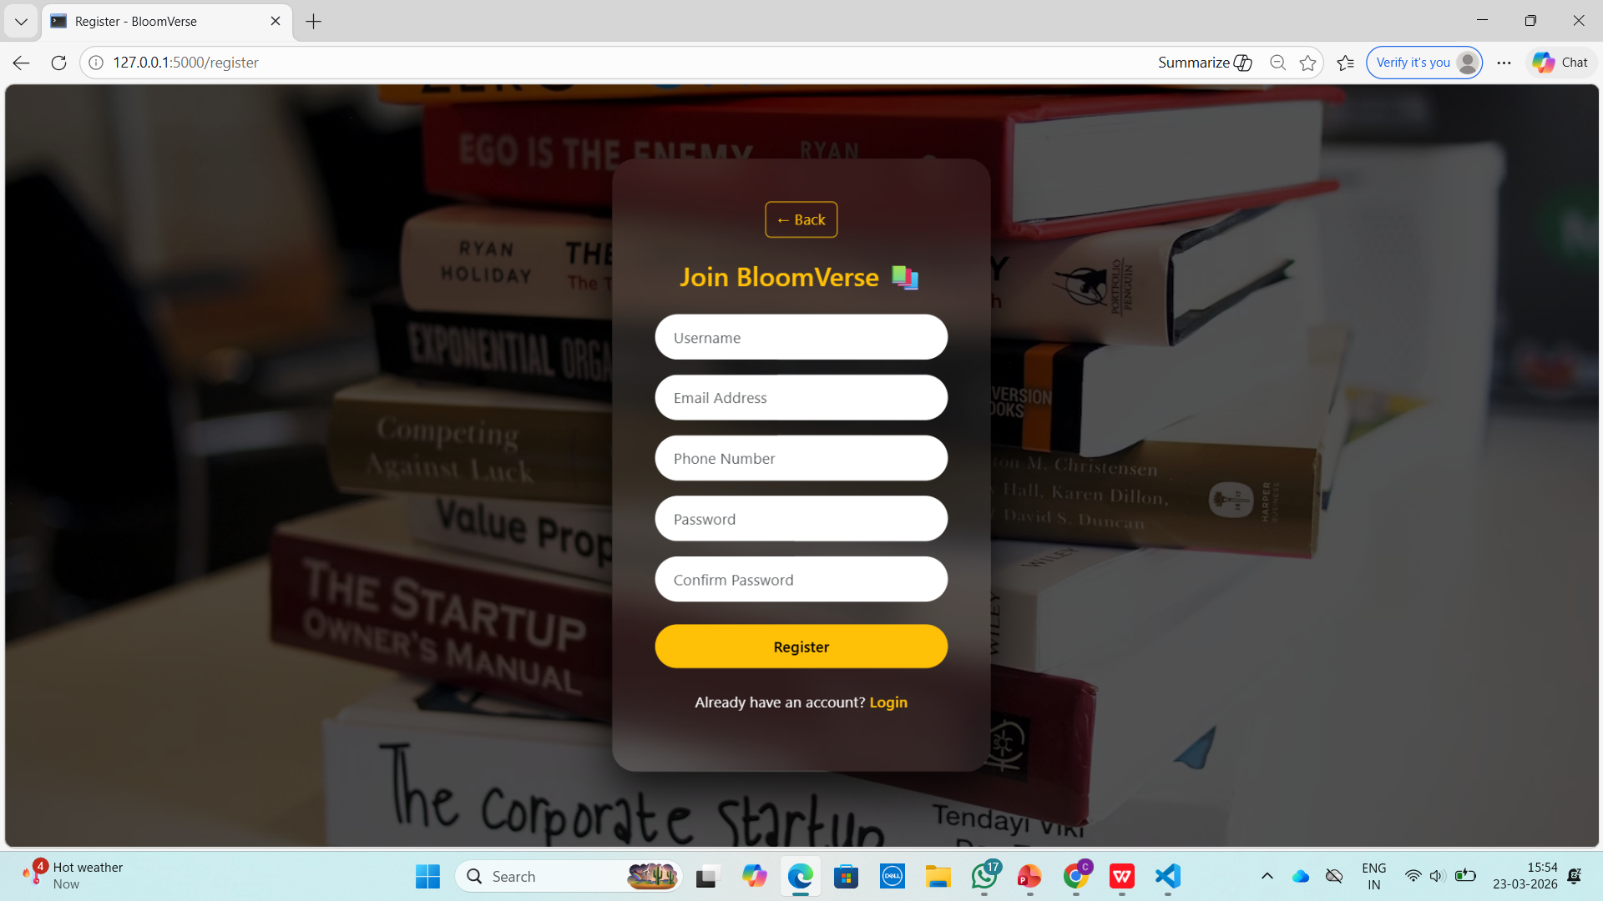
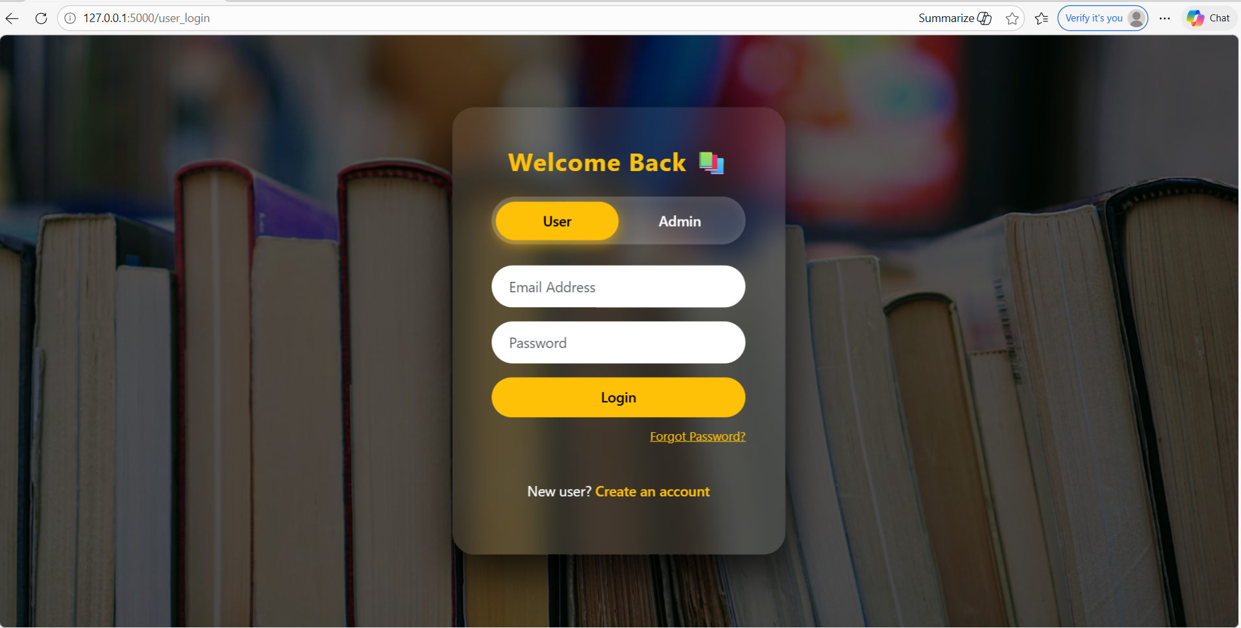
Register & Login Page

Slide 12
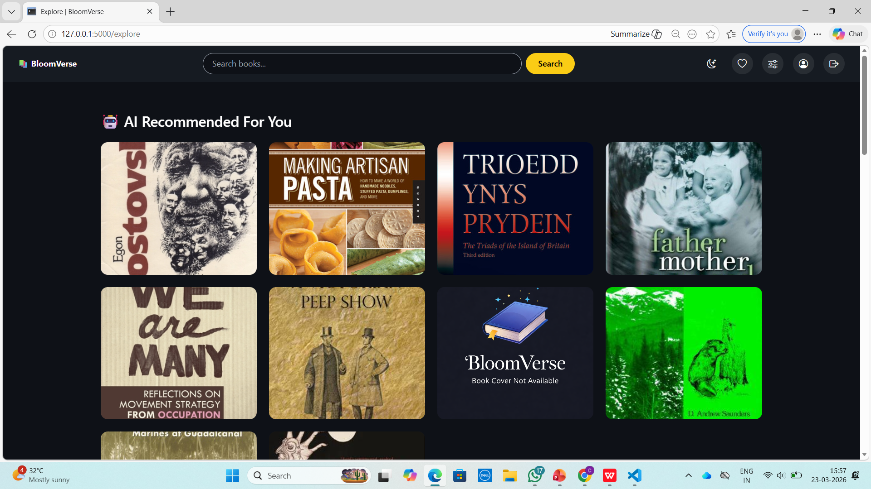
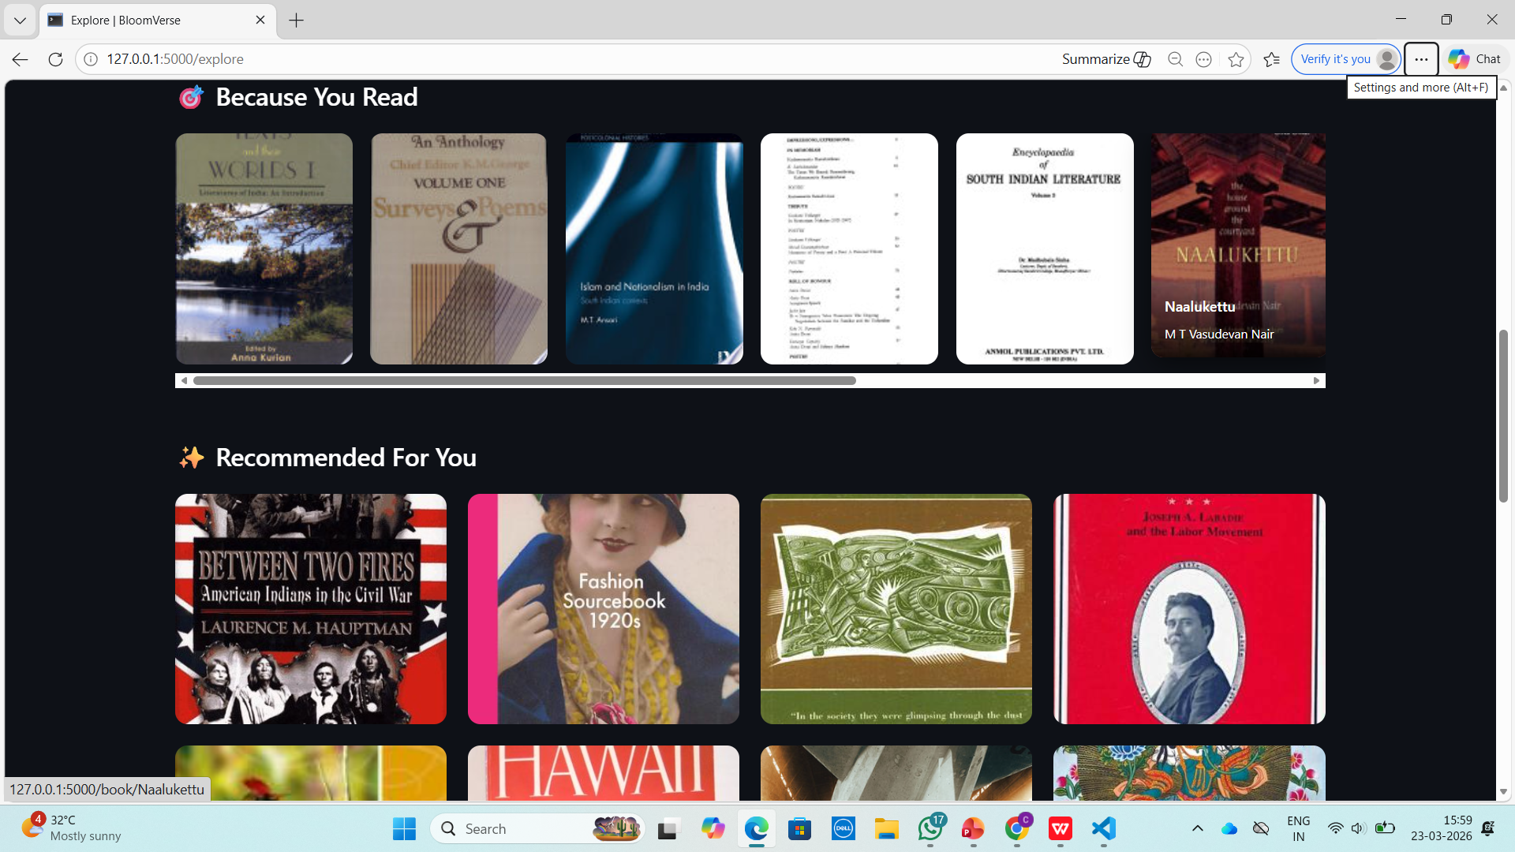
Book Recommendation Results

Slide 13
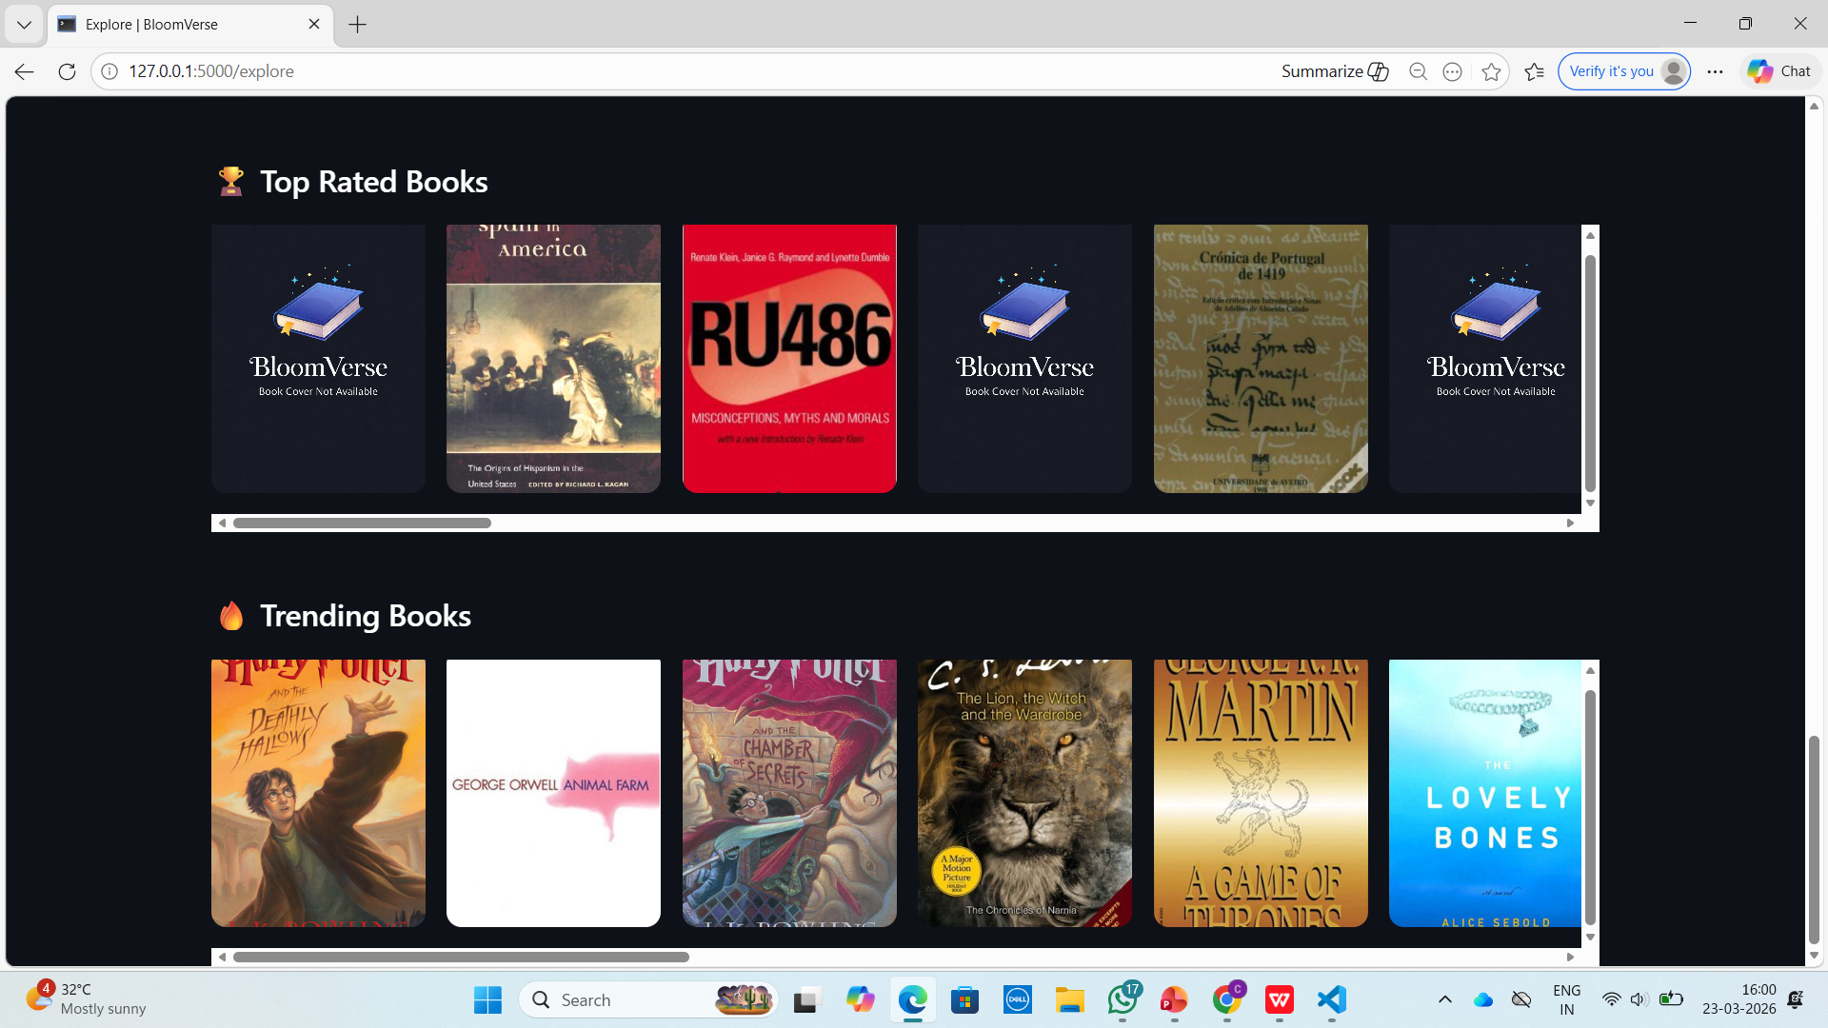
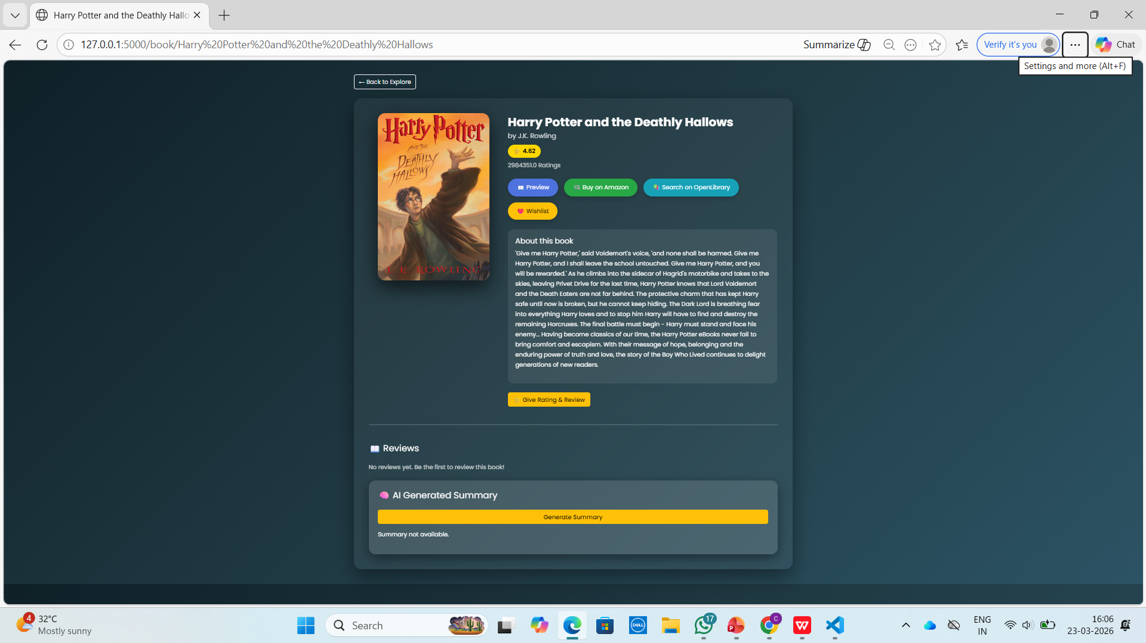
Book Recommendation Results

Slide 14

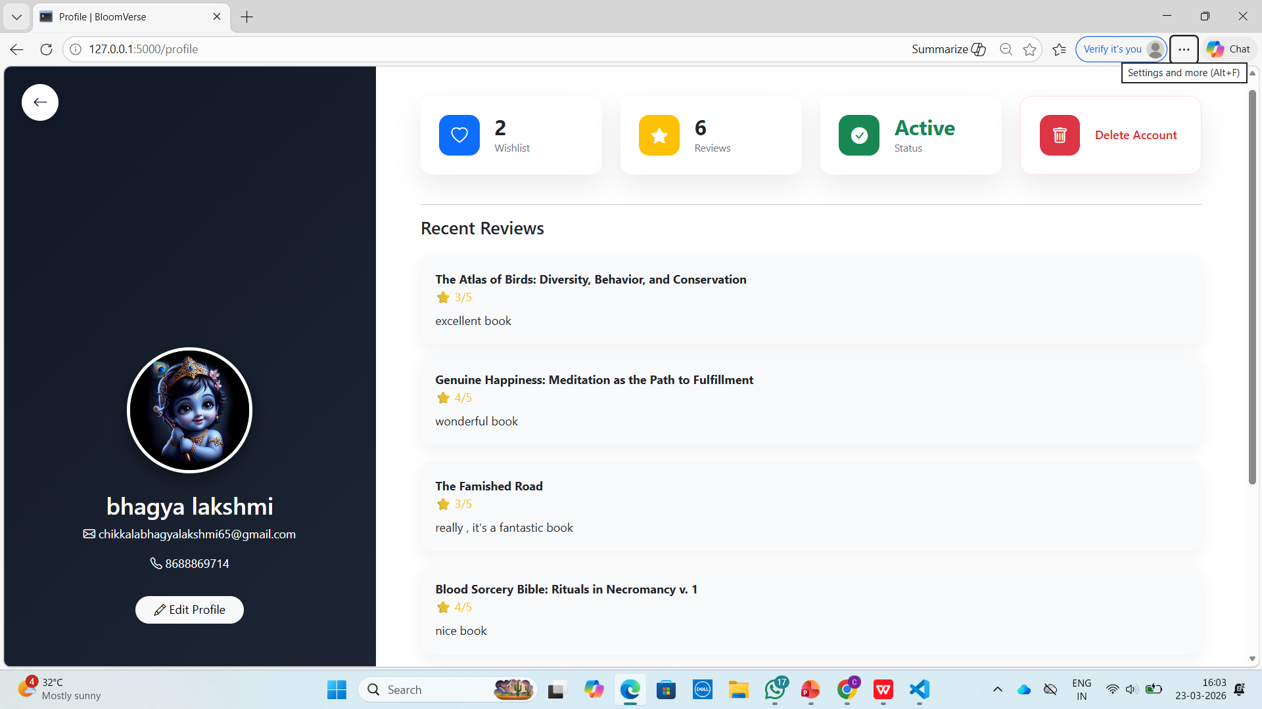
Wishlist & User Profile

Slide 15
Conclusion
The BloomVerse system provides personalized book recommendations using collaborative filtering and cosine similarity.
It analyzes user preferences to generate accurate suggestions, while NLP-based summaries help users understand book content quickly.
The system improves user experience by reducing manual effort and delivering meaningful recommendations.

Slide 16
References
Sun, D., He, T., & Zhang, H. (2012). Survey of Cold-start Problem in Collaborative Filtering Recommender System. Computer and Modernization, 5, 59–63.
Zhang, C., Sun, F., Fang, C., & Guo, R. (2017). Collaborative Filtering Algorithm with Stability of Interest and Time-Sensitive. Computer Engineering and Applications, May 2017.
Jannach, D., Zanker, M., Felfernig, A., & Friedrich, G. (2011). Recommender Systems: An Introduction. Cambridge University Press.
Luo, Z. (2012). Realization of Individualized Recommendation System on Book Sales. IEEE International Conference on Management of e-Commerce and e-Government, 10–13.
Sarwar, B., Karypis, G., Konstan, J., & Riedl, J. (2001). Item-based Collaborative Filtering Recommendation Algorithms. Proceedings of the 10th International World Wide Web Conference (WWW), 285–295.
Resnick, P., Iacovou, N., Suchak, M., Bergstrom, P., & Riedl, J. (1994). GroupLens: An Open Architecture for Collaborative Filtering of Netnews. ACM Conference on Computer Supported Cooperative Work, 175–186.

Slide 17
QUERIES ?

Slide 18


